Slide 1
America’s
Air Quality
Project 1 - Team 7

Slide 2
THIS IS
OUR
TEAM
Mariama Diallo
Herman Tucker
Blanca Carretero

Slide 3
01
02
INTRODUCTION
OVERVIEW
03
04
ANALYSIS
CONCLUSION
Introduction to Air Quality
Topics Ahead
Analysis of Air Pollutants
Concluding Message

Slide 4
INTRODUCTION
Air quality plays a very important role in our daily lives, it affects everybody.
We need clean and safe air to live well, and air pollution can trigger many health issues.
The issue is especially important today because of its great impact on our future and thus need to increase our awareness.

Slide 5
TOPICS AHEAD
Emissions of air pollutants continue to play an important role in a number of air quality issues
We will analyze the trends of 3 major air pollutants across various cities in the United States:
O3 (Ozone)
NO2 (Nitrogen Dioxide)
SO2 (Sulfur Dioxide)

Slide 6
ANALYSIS
Ozone (O3)

Slide 7
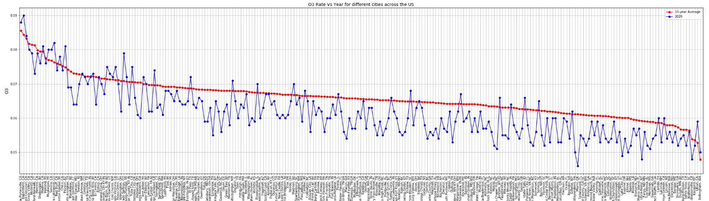
ANALYSIS
Ground-level ozone can also damage vegetation and ecosystems
The pollutant can cause mass die-off in crops, reducing growth and increasing disease

Slide 8
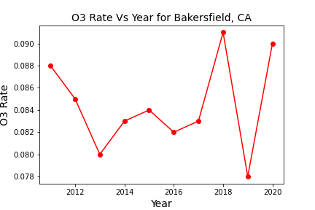
ANALYSIS
The states with highest levels of O3 are California, Indiana and Arizona
Overall, most cities have stayed below the average in the last 2 years
The number has decreased in the last 10 years, but has quickly jumped after 2019

Slide 9
ANALYSIS
Nitrogen Dioxide (NO2)

Slide 10
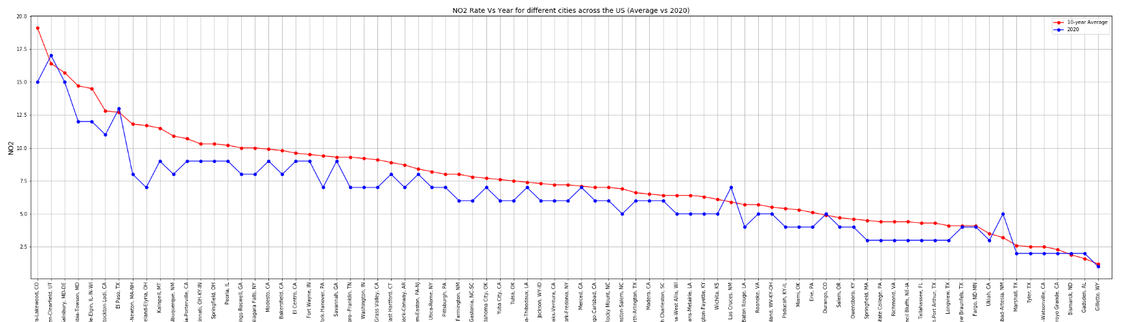
ANALYSIS
NO2 can damage foliage, decrease growth/reduce crop yields
Can also fade and discolour furnishings and fabrics, reduce visibility, and react with surfaces

Slide 11
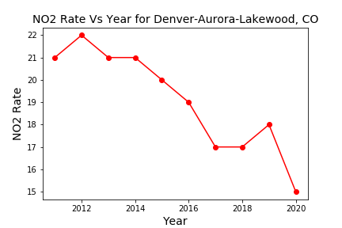
ANALYSIS
The states with highest levels of NO2 are Maryland-Delaware, Illinois, and Colorado
Overall, most cities stayed below the average in 2020
Denver, CO has slowly decreased in number over time with a slight increase in 2019.

Slide 12
ANALYSIS
Sulfur
Dioxide (SO2)

Slide 13
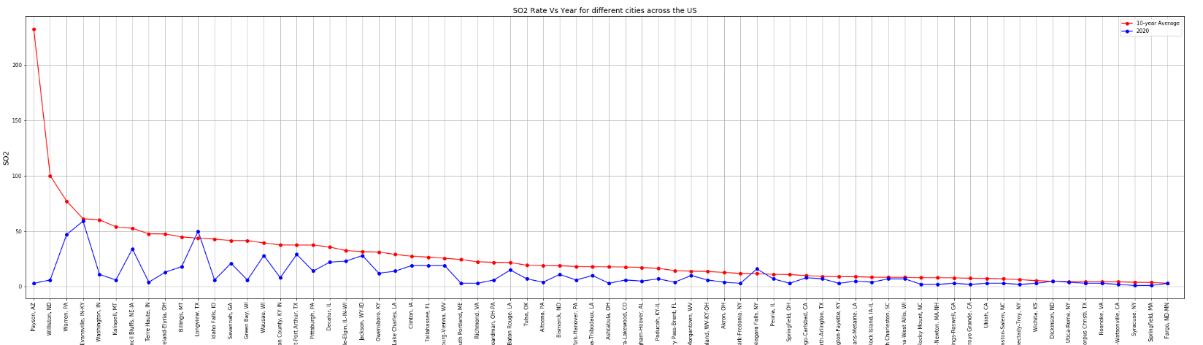
ANALYSIS
SO2 can transform into sulfuric acid (acid rain)
Acid rain can cause deforestation and acidify waterways to the detriment of aquatic life

Slide 14
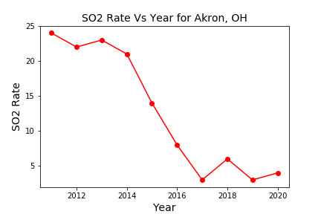
ANALYSIS
The states with highest levels of SO2 are Ohio, New York, and Pennsylvania
Overall most cities have stayed below average in 2020
The level of SO2 has been decreasing for the most part in Akron OH, but there was a slight increase in 2018, then a decrease in 2019 and it started going up a bit in 2020.

Slide 15
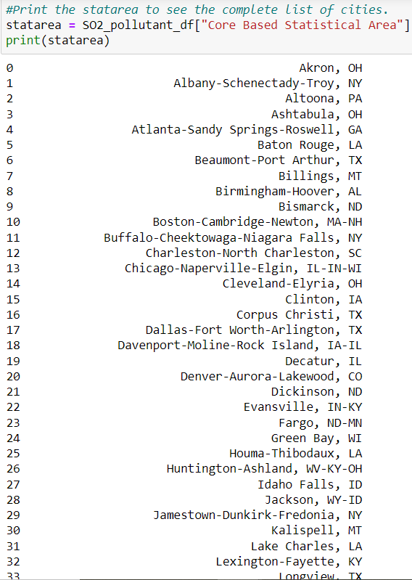
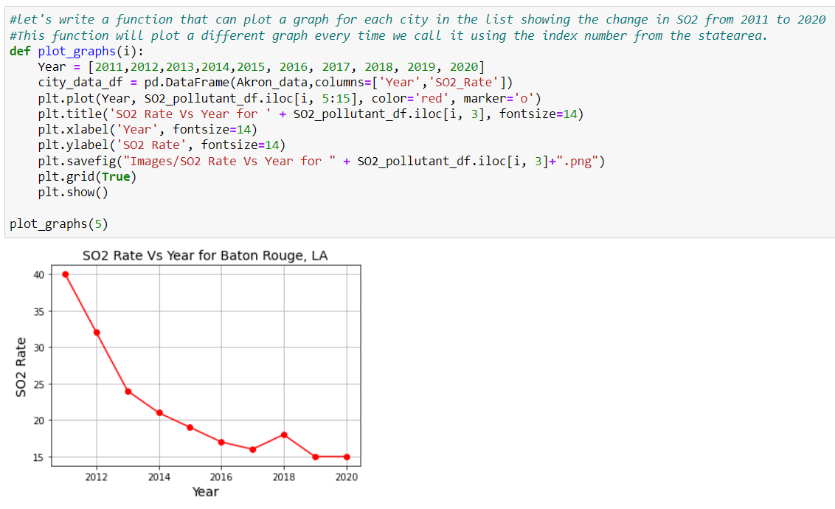
CHOOSE A CITY FUNCTION

Slide 16
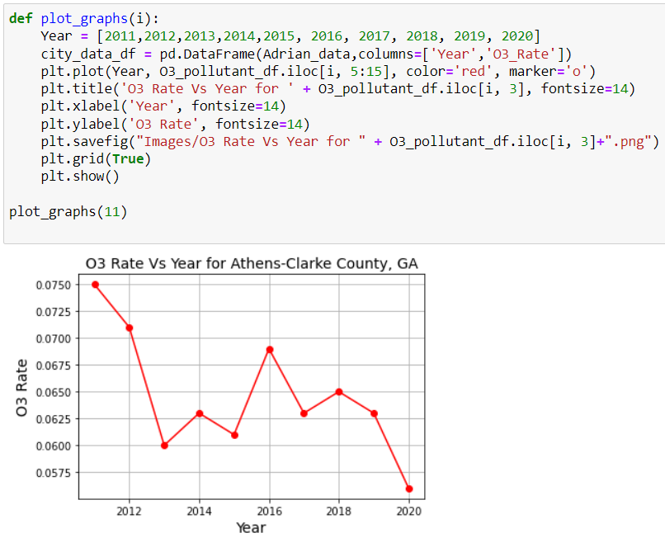
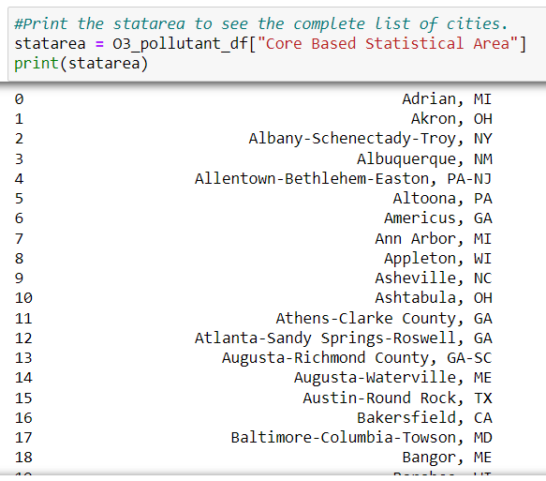
CHOOSE A CITY FUNCTION

Slide 17
CONCLUSION
In the last 10 years, air pollution has decreased thanks to the Clean Air Act
There has been a jump in air pollution after 2020, but mostly for O3 (Ozone)
The Clean Air act has helped decrease acid rain, improve visibility, and protect the ozone layer
If more countries around the world implemented their own regulations against air pollution, the whole world could help decrease air pollution in the next 10 years
We need to be mindful, as air pollution affects each and every one of us

Slide 18

Thank you!
Do you have any questions?

